Slide 1
Lesson 4
Writing Executable Statements

Slide 2
Objective
After completing this lesson, you should be able to do the following:
  Identify the lexical units in a PL/SQL block
  Use built-in SQL functions in PL/SQL
  Describe when implicit conversions take place and when explicit conversions have to be dealt with
  Write nested blocks and qualify variables with labels
  Write readable code with appropriate indentation
  Use sequences in PL/SQL expressions

Slide 3
Lesson Agenda
  Writing executable statements in a PL/SQL block
  Writing nested blocks
  Using operators and developing readable code

Slide 4
Lexical Units in a PL/SQL Block
Lexical units:
  Are building blocks of any PL/SQL block
  Are sequences of characters, including letters, numerals, tabs, spaces, returns, and symbols
  Can be classified as:
    Identifiers: v_fname, c_percent
    Delimiters: ; , +, -
    Literals: John, 428, True
    Comments: --, /* */
Notes:
Java SE 8 Programming 2 - <number>

Slide 5
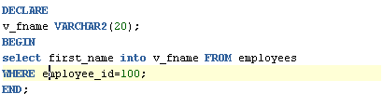
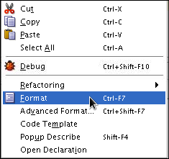


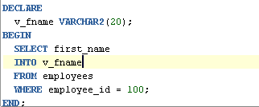

PL/SQL Block Syntax and Guidelines
  Using Literals
    Character and date literals must be enclosed in single quotation marks.
    Numbers can be simple values or in scientific notation.
  Formatting Code: Statements can span several lines.
v_name := 'Henderson';
2
1
3

Slide 6
Commenting Code
  Prefix single-line comments with two hyphens (--).
  Place a block comment between the symbols /* and */.
Example:
DECLARE
...
v_annual_sal NUMBER (9,2);
BEGIN
/* Compute the annual salary based on the
monthly salary input from the user */
v_annual_sal := monthly_sal * 12;
--The following line displays the annual salary DBMS_OUTPUT.PUT_LINE(v_annual_sal);
END;
/

Slide 7
SQL Functions in PL/SQL
  Predefined functions that are used in SQL can also be used in PL/SQL.
  Functions that are available in procedural statements are:
    Single-row functions
    Built-in functions with Strings
    Built-in functions with Numbers
    Built-in functions with Dates
  Functions that are not available in procedural statements are:
    DECODE
    Group functions

Slide 8
SQL Functions in PL/SQL: Examples
  Get the length of a string:
v_desc_size INTEGER(5);
v_prod_description VARCHAR2(70):='You can use this product with your radios for higher frequency';
-- get the length of the string in prod_description
v_desc_size:= LENGTH(v_prod_description);
  Get the number of months an employee has worked
  v_tenure:= MONTHS_BETWEEN (CURRENT_DATE, v_hiredate);

Slide 9
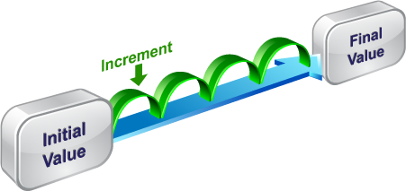
Using Sequences in PL/SQL blocks
  Sequences are database objects that can be used by multiple users to generate sequential numbers.
  Sequences can be created through the CREATE SEQUENCE statement.
CREATE SEQUENCE emp_sequence
INCREMENT BY 1
START WITH 1
NOMAXVALUE;

Slide 10

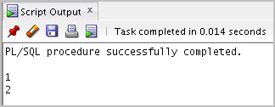
Using Sequences in PL/SQL Blocks
CREATE SEQUENCE my_seq
INCREMENT BY 1
START WITH 1
NOMAXVALUE;
DECLARE
v_new_id NUMBER;
BEGIN
v_new_id := my_seq.NEXTVAL;
BMS_OUTPUT.PUT_LINE(v_new_id); DBMS_OUTPUT.PUT_LINE(my_seq.NEXTVAL);
END;

Slide 11

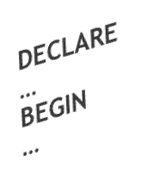

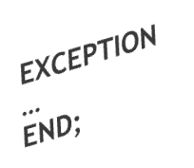
Nested blocks
PL/SQL blocks can be nested.
  An executable section (BEGIN … END) can contain nested blocks.
  An exception section can contain nested blocks.

Slide 12
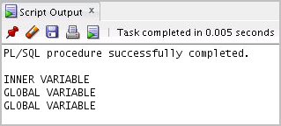
Nested Blocks: Example
DECLARE
v_outer_variable VARCHAR2(20):='GLOBAL VARIABLE';
BEGIN
DECLARE
v_inner_variable VARCHAR2(20):='INNER VARIABLE';
BEGIN
DBMS_OUTPUT.PUT_LINE(v_inner_variable);
DBMS_OUTPUT.PUT_LINE(v_outer_variable);
END;
DBMS_OUTPUT.PUT_LINE(v_outer_variable);
END;

Slide 13
Variable Scope and Visibility
DECLARE
v_father_name VARCHAR2(20):='Patrick';
v_date_of_birth DATE:='20-Apr-1972';
BEGIN
DECLARE
v_child_name VARCHAR2(20):='Mike';
v_date_of_birth DATE:='12-Dec-2002';
BEGIN
DBMS_OUTPUT.PUT_LINE('Father''s Name: '||v_father_name);
DBMS_OUTPUT.PUT_LINE('Date of Birth: '||v_date_of_birth);
DBMS_OUTPUT.PUT_LINE('Child''s Name: '||v_child_name);
END;
DBMS_OUTPUT.PUT_LINE('Date of Birth: '||v_date_of_birth);
END;
/

Slide 14
Using a Qualifier with Nested Blocks
BEGIN <<outer>>
DECLARE
v_father_name VARCHAR2(20):='Patrick';
v_date_of_birth DATE:='20-Apr-1972';
BEGIN
DECLARE
v_child_name VARCHAR2(20):='Mike';
v_date_of_birth DATE:='12-Dec-2002';
BEGIN
DBMS_OUTPUT.PUT_LINE('Father''s Name: '||v_father_name);
DBMS_OUTPUT.PUT_LINE('Date of Birth: '
||outer.v_date_of_birth);
DBMS_OUTPUT.PUT_LINE('Child''s Name: '||v_child_name);
DBMS_OUTPUT.PUT_LINE('Date of Birth: '||v_date_of_birth);
END;
END;
END outer;

Slide 15

Challenge: Determining the Variable Scope
BEGIN <<outer>>
DECLARE
v_sal NUMBER(7,2) := 60000;
v_comm NUMBER(7,2) := v_sal * 0.20;
v_message VARCHAR2(255) := ' eligible for commission';
BEGIN
DECLARE
v_sal NUMBER(7,2) := 50000;
v_comm NUMBER(7,2) := 0;
v_total_comp NUMBER(7,2) := v_sal + v_comm;
BEGIN
v_message := 'CLERK not'||v_message;
outer.v_comm := v_sal * 0.30;
END;
v_message := 'SALESMAN'||v_message;
END;
END outer;
/
1
2

Slide 16
Operators in PL/SQL
  Logical
  Arithmetic
  Concatenation
  Parentheses to control order
  of operations
  Exponential operator (**)

Slide 17
Operators in PL/SQL: Examples
  Increment the counter for a loop.
    loop_count := loop_count + 1;
  Set the value of a Boolean flag.
    good_sal := sal BETWEEN 50000 AND 150000;
  Validate whether an employee number contains a value
  valid := (empno IS NOT NULL);

Slide 18
Programming Guidelines
Make code maintenance easier by:
  Documenting the code with comments
  Developing a case convention for the code
  Developing naming conventions for identifiers and other objects
  Enhancing readability by indenting

Slide 19
Indenting Code
For clarity, indent each level of code.
BEGIN
IF x=0 THEN
y:=1;
END IF;
END;
/
DECLARE
v_deptno NUMBER(4);
v_location_id NUMBER(4);
BEGIN
SELECT department_id,
location_id
INTO v_deptno,
v_location_id
FROM departments
WHERE department_name
= 'Sales';
...
END;
/

Slide 20
Quiz
You can use most single-row SQL functions such as number, character, conversion, and date in PL/SQL expressions.
  True
  False

Slide 21
Summary
In this lesson, you should have learned how to:
  Identify the lexical units in a PL/SQL block
  Use built-in SQL functions in PL/SQL
  Write nested blocks to break logically related functionalities
  Decide when to perform explicit conversions
  Qualify variables in nested blocks
  Use sequences in PL/SQL expressions

